Slide 1
iModels Explained
SLIPPER , RULEFit , FIGS

Slide 2
I) SLIPPER
Since I’ll be using the breast cancer dataset for binary classification tasks, let’s explain how SLIPPER works using a subset of that dataset.
Our target variable is “Malignant”
0 – “no”
1 – “yes”
Sample ID | Tumor Size | Clump Thickness | Uniformity of Cell Size | Malignant
1 | 5 | 3 | 2 | 0
2 | 7 | 8 | 6 | 1
3 | 4 | 2 | 3 | 0
4 | 8 | 9 | 7 | 1
5 | 6 | 4 | 5 | 0

Slide 3
SLIPPER: Initialization (using an example)
Let’s start with initializing the SLIPPER model:
There are two main elements when you consider the SLIPPER model:
The Rule Set
The Weights
Both are initialized when you start the model.
The rule set is set to Empty: The model starts with no rules. At this point, the rule set is completely empty.
Equal Weights: Each training example (Samples in this case) is assigned an equal weight. Since we have 5 examples, each will be given a weight of 1/5 = 0.2.
So, the initial state of our model looks like this:
Rules: []
Weights: [0.2, 0.2, 0.2, 0.2, 0.2]
This initialization ensures that,
The model starts with a clean slate, ready to learn rules from the data.
All training examples are initially considered equally important for learning.
Sample ID | Tumor Size | Clump Thickness | Uniformity of Cell Size | Malignant
1 | 5 | 3 | 2 | 0
2 | 7 | 8 | 6 | 1
3 | 4 | 2 | 3 | 0
4 | 8 | 9 | 7 | 1
5 | 6 | 4 | 5 | 0

Slide 4
SLIPPER: Rule Generation
After initialization, SLIPPER generates and selects rules based on the data.
Let's say it generates the following rule:
"IF Clump Thickness > 6 AND Uniformity of Cell Size > 5 THEN Malignant”
After applying the rule, we get the following table.
Weight Update:
Since all examples are correctly classified, the weights remain largely unchanged, but typically, they might adjust slightly to focus on more challenging cases in future iterations.
So, the state of our model after one iteration looks like this:
Rules: [ IF Clump Thickness > 6 AND Uniformity of Cell Size > 5 THEN Malignant, ]
Weights: [ 0.2, 0.2, 0.2, 0.2, 0.2 ]
In subsequent iterations, SLIPPER will:
Generate new rules focusing on misclassified or challenging examples.
Select rules that best reduce classification error.
Update weights to emphasize harder-to-classify samples.
Until the iteration threshold is met.
Sample ID | Clump Thickness | Uniformity of Cell Size | Rule Applies | Actual Malignant | Correct?
1 | 3 | 2 | No | No | Yes
2 | 8 | 6 | Yes | Yes | Yes
3 | 2 | 3 | No | No | Yes
4 | 9 | 7 | Yes | Yes | Yes
5 | 4 | 5 | No | No | Yes

Slide 5
SLIPPER: Misclassified samples
What happens when a sample gets misclassified?
Let's say it generates the following rule:
"IF Clump Thickness > 6 THEN Malignant"
Now, let's assume the rule incorrectly classifies Sample ID 5 as malignant (when it's not).
Since Sample ID 5 was misclassified, its weight will be increased to emphasize it in the next iteration..
Before update:
Weights: [0.20, 0.20, 0.20, 0.20, 0.20]
Rules: [ IF Clump Thickness > 6 AND Uniformity of Cell Size > 5 THEN Malignant, ]
After update:
Weights: [0.18, 0.18, 0.18, 0.18, 0.28]
Rules: [ IF Clump Thickness > 6 AND Uniformity of Cell Size > 5 THEN Malignant, IF Clump Thickness > 6 THEN Malignant, ]
The weight for Sample ID 5 increases to focus more on its correct classification in future iterations.
Sample ID | Clump Thickness | Rule Applies | Actual Malignant | Correct?
1 | 3 | No | No | Yes
2 | 8 | Yes | Yes | Yes
3 | 2 | No | No | Yes
4 | 9 | Yes | Yes | Yes
5 | 4 | No | No | Yes

Slide 6
SLIPPER: When do you not add a rule to the list ?
Handling Poor Rules:
Rule Evaluation: Each rule is evaluated based on its ability to correctly classify the training examples. This involves calculating a weighted error for the rule.
Selection Criteria: Only rules that perform well (i.e., have a low weighted error) are selected to be part of the final ensemble. Poor rules with high errors are generally not added to the rules list.
Boosting Process: The boosting mechanism in SLIPPER ensures that only effective rules are retained. If a rule doesn't improve classification accuracy, it is discarded.
Confidence Measures: SLIPPER uses confidence ratings to determine the usefulness of a rule. Rules with negative confidence (indicating poor performance) are not included
So, in simple terms, if a RULE misclassifies a lot of samples, its weighted error will be high. This results in two outcomes:
Not Added: Due to its high error rate, this rule would not be added to the ensemble.
Focus Shift: The model will focus on generating new rules that better handle the misclassified examples.
This error rate threshold is inherent to the model itself. (didn’t really get any info to dig deeper into this).
This whole process of generating the rules and updating the weights continues on, until the iteration threshold is met.

Slide 7
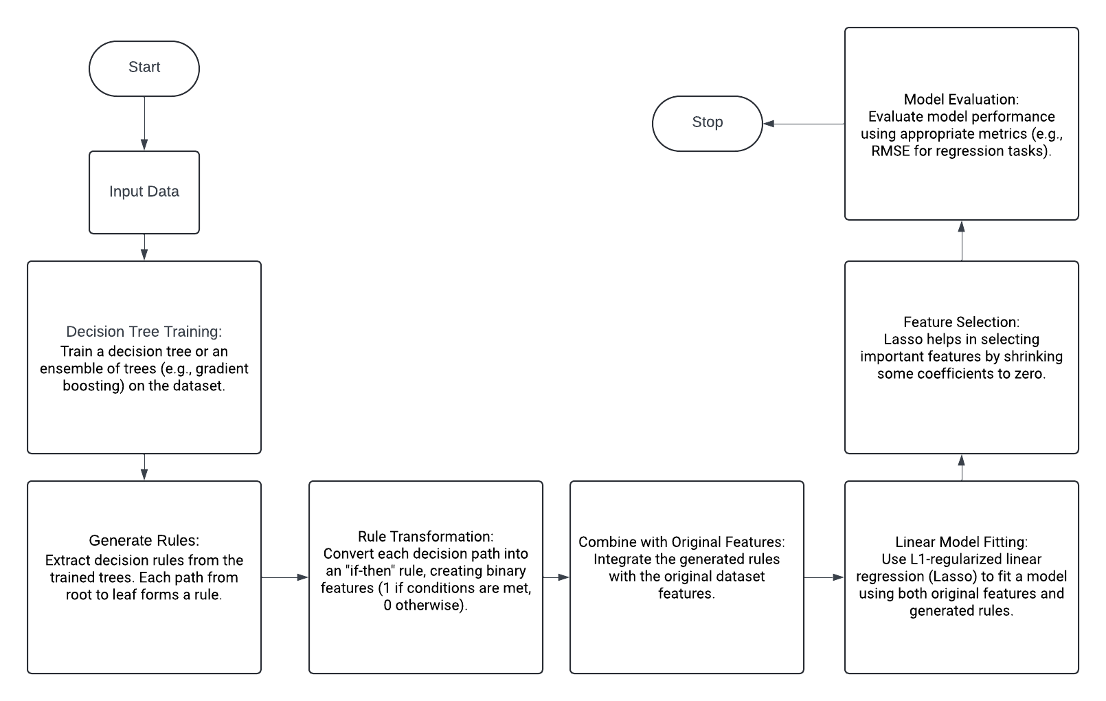
RuleFit algorithm Flowchart

Slide 8
II) FIGS
The FIGS model, is designed to create an ensemble of decision trees. Each tree in this ensemble will focus on different aspects of the data.
I’ll be using the Breast cancer dataset to explain it with an iteration:
We want to classify a new tumor with these characteristics:
Mean Radius: 15.0
Mean Texture: 20.0
Sample ID | Mean Radius | Mean Texture | Actual Class
1 | 14.0 | 15.0 | Benign
2 | 16.0 | 20.0 | Malignant
3 | 13.5 | 18.0 | Benign
4 | 15.5 | 22.0 | Malignant

Slide 9
FIGS: Initial Tree Prediction
The first decision tree might focus on the Mean Radius:
New Entry: Mean Radius = 15.0, so the prediction is Malignant.
Feature | Threshold | Decision
Mean Radius | > 14.5 | Predict Malignant
Mean Radius | <= 14.5 | Predict Benign

Slide 10
FIGS: Residuals and Second Tree
The second tree might focus on the Mean Texture to refine predictions:
New Entry:
Mean Texture = 20.0, and since Mean Radius = 15.0, the second tree suggests adjusting the prediction slightly towards Benign, but given the radius, it remains leaning towards Malignant.
Feature | Threshold | Decision
Mean Texture | > 18.5 | Adjust towards Benign if Mean Radius < 15.5
Mean Texture | <= 18.5 | No adjustment

Slide 11
FIGS: Final Ensemble Decision
Tree Number | Contribution to Prediction
Tree 1 | Strong Malignant
Tree 2 | Slight adjustment towards Benign
The FIGS model combines these insights:
Tree 1 Prediction: Malignant
Tree 2 Adjustment: Slight adjustment towards Benign due to texture

Slide 12
FIGS: Final Prediction Table
The predictions from both trees are combined to form an ensemble decision. Each tree's output is weighted based on its accuracy in reducing residuals.
Tree Number | Contribution to Prediction
Tree 1 | Strong Malignant
Tree 2 | Slight adjustment towards Benign

Slide 13
FIGS: Edge Cases
1. Ambiguous Data
Scenario: If a tumor has a mean radius and texture that fall near decision boundaries (e.g., Mean Radius = 14.5, Mean Texture = 18.5), it might be difficult for the model to confidently classify it.
Handling: FIGS will use its ensemble approach to weigh both trees' contributions, potentially leading to a more cautious prediction with lower confidence.
2. Outliers
Scenario: A sample with extreme values (e.g., very high mean radius but low texture) might not fit well into any learned pattern.
Handling: The model may rely more heavily on whichever tree provides a clearer prediction path or flag this sample for further review due to its atypical nature.
3. Limited Data
Scenario: With very few samples, the model might struggle to find meaningful splits.
Handling: FIGS can adjust by limiting complexity further and focusing on the most significant features available, but performance may be constrained by data limitations.

